Slide 1

Production- Sub Assembly
23th July 2020

Slide 2
Agenda
Discussion Items
Milestones/Business Review
COVID Situation Review
AOB

Slide 3

Our Mission
We exist to imagine and deliver technology that improves life in the world’s fastest growing cities

Slide 4
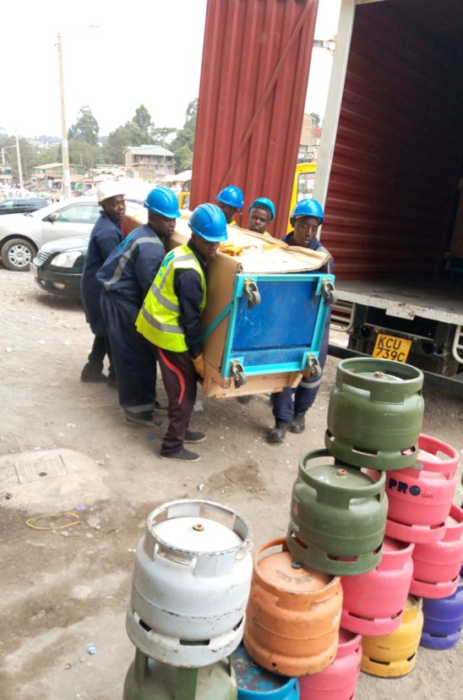
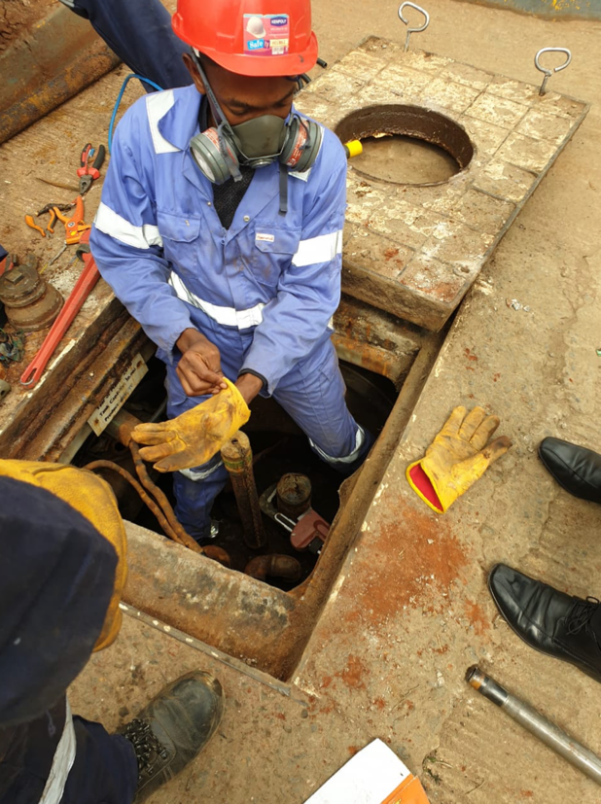
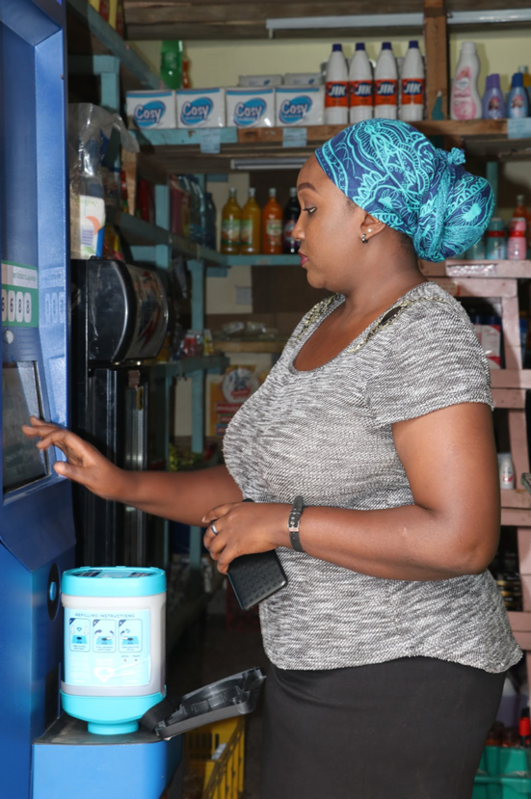
Deliver technology…

Slide 5
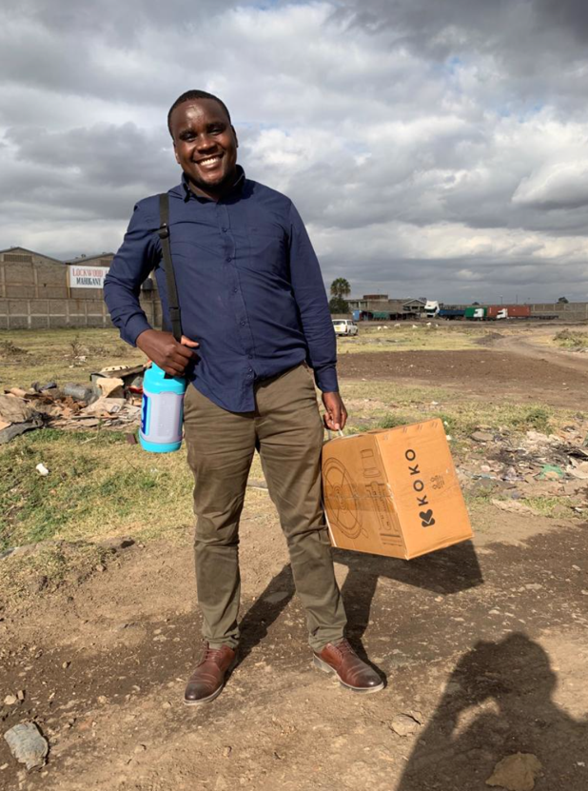
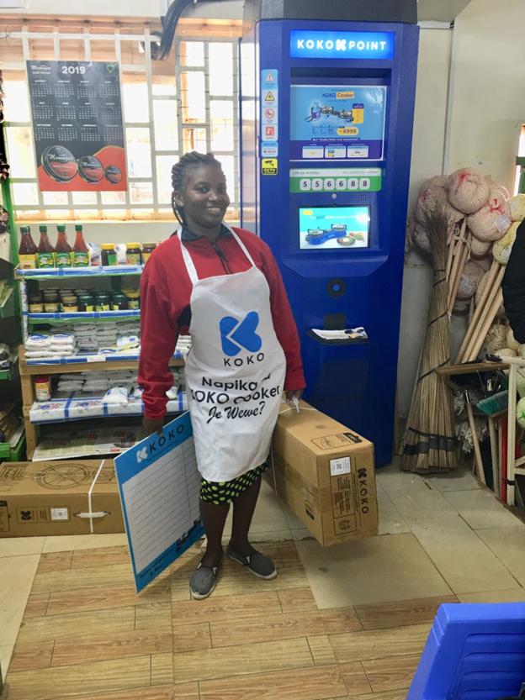
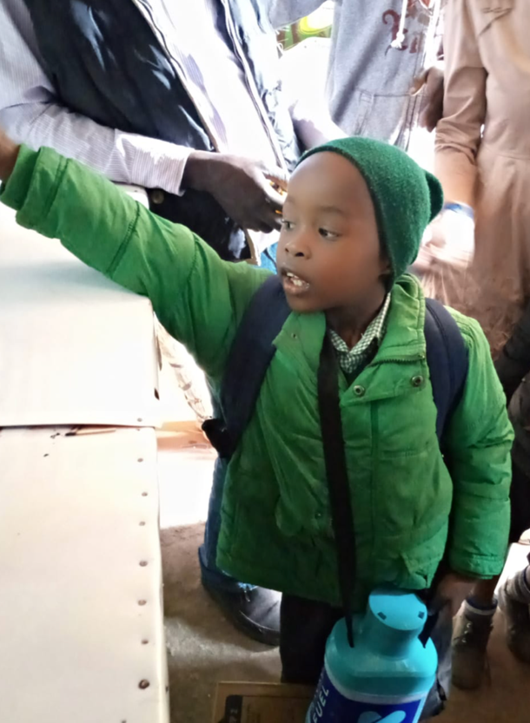
… that improves lives

Slide 6
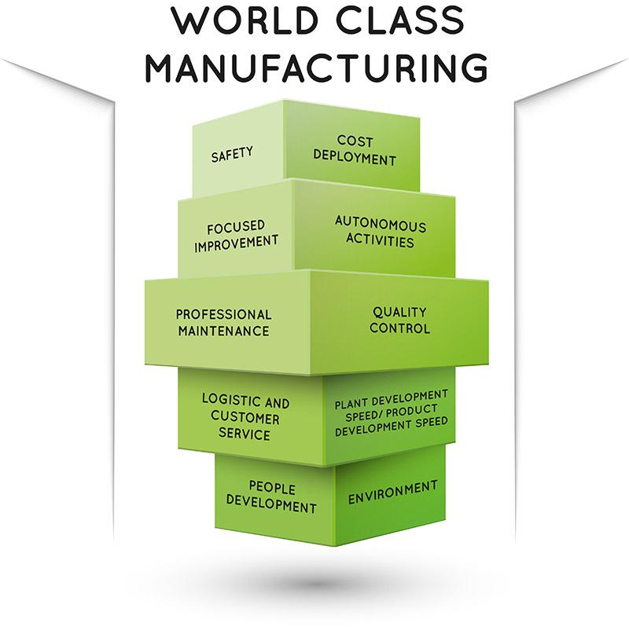
Vision & Mission
Vision
To become a world class manufacturing facility
Mission
To deliver products that meet customers demands, on schedule, with the right quality and at the lowest cost
Live & Work by Values
Customer focus. Safety Professionalism. Accountability
Drive Quality
Product & process. Six sigma principles
Lean Production
Values stream mapping. Reduce waste. Automation. Process improvements. ERP review & implementation
Create Visibility
Well defined data structures. Process documentation.

Slide 7
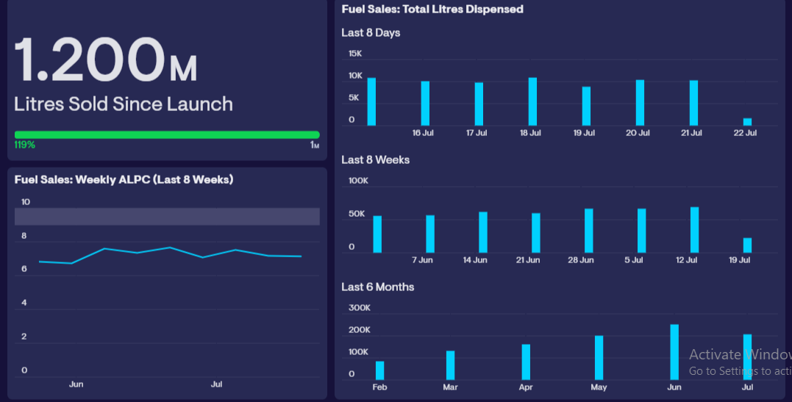
Fuel sales
Source data

Slide 8
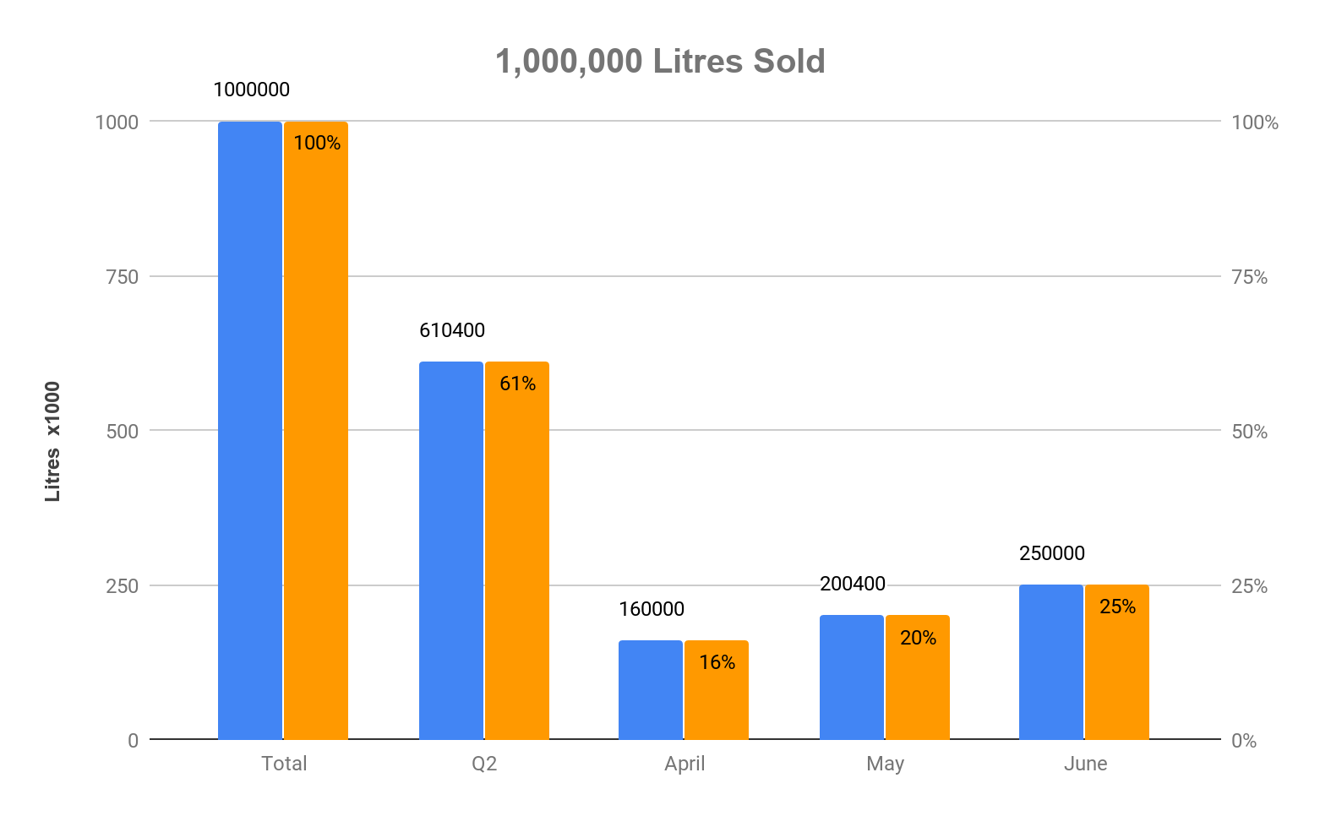
1,000,000 Litres! achieved by Q2
Source data

Slide 9


Next Milestone
25000 cookers in Q3 to be achieved through Individuals + Team Work
Sick Staff ≠ 25000 Cookers
Afraid Staff ≠ 25000 Cookers

Slide 10

COVID-19

Slide 11

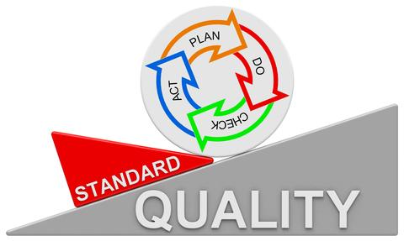
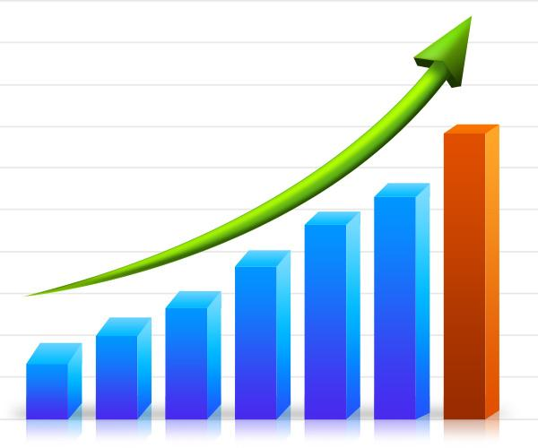

COVID-19 : Let’s Protect Each Other
Keep the wheel rolling
Continuous Growth
Happy Staff. Happy Customers. Happy Business

Slide 12

Thank you

